Slide 1
Application of Blockchain in Benami Transactions
Abhishek S Patil
Bharath S
6th Sem- ECE
JSS Science and Technology University

Slide 2
Introduction
“Benami” basically means “without a name”.
“Benami transaction” is defined as an act of transaction or arrangement of property.
Payment for such a property is done by another person.
Blockchain technology is a distributed ledger technology which acts as a data structure.
Removes the central Servers.

Slide 3
Analysis
Real estate sector in India is expected to reach US$ 650 billion.
Its share in India's Gross Domestic Product (GDP) is projected increase to 17 per cent by 2040.
A total of US$1.4 trillion black money is held in Switzerland.

Slide 4
New Blockchain
User details are stored using Smart Contracts.
Hashing is a technique which gives encrypted output when an input of any length is given to the hash function.
Digital signature is attached to an electronically transmitted document to verify its contents and the sender's identity.

Slide 5

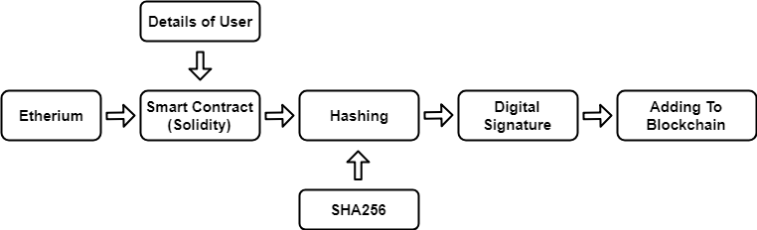

Slide 6
Data Collection
Two phases- Seller validation and Buyer validation.
Details to be entered are name of the person who owns the property, property details etc.
Suitable amount will be decided according to the location.
An ID will be generated for each of the selling property.
The entire information regarding the property can be fetched using the ID.

Slide 7
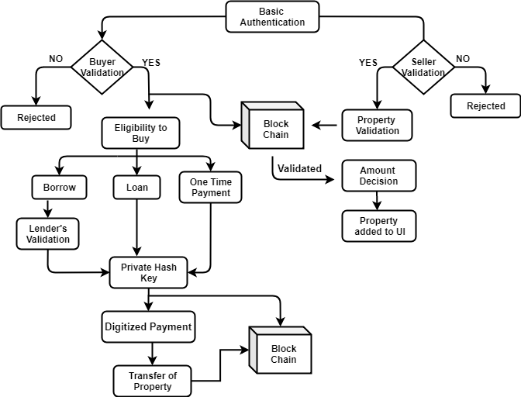

Slide 8
Buyer Validation
Buyer will be asked to enter details such as name, properties under his name, source of income and identity proof.
Source of income is the key parameter.
The basic three modes of achieving this capability is either by his income which reflects as his bank balance or borrow money from a financially strong person who may be a friend or relative of the buyer or getting a loan from any Financial organization.
If the buyer wishes to borrow amount from a financially strong person the details of the money lender has to be entered.
Loan details have to be entered in order to buy the property if he chooses third option.
Whisper protocol is used to communicate between seller and buyer.

Slide 9
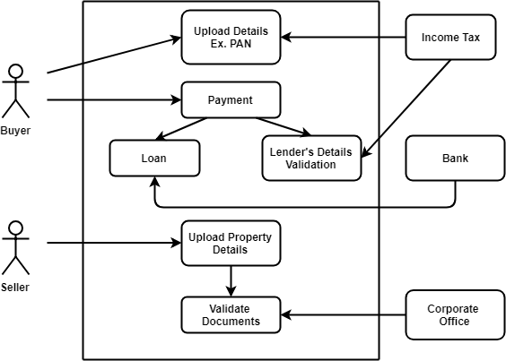

Slide 10
After validating the method by which the buyer wishes to buy the property, he will be taken to the next stage.
The second stage displays details of all the properties which he can afford.
All the ID’s generated in the seller validation phase will be displayed.
After the purchase a new block will be created indicating the new owner of the property and his details attached to it.
In the future if he wishes to buy or sell any property then his details could be fetched directly from the existing Blockchain.
Second major advantage is avoiding black money.

Slide 11
Thank You…!!!

